Slide 1
Airbnb and Crime report in Vancouver
Shangchen Han

Slide 2
Introduction:
Travel becomes more popular than before, because of releasing pressure during daily life. But traveler is likely to consider the price and quality of the accommodation as their first two concern. Furthermore, travelers need to concern their safety during the trip. Thus, this project is about the Airbnb’s price and the crime around the place.

Slide 3
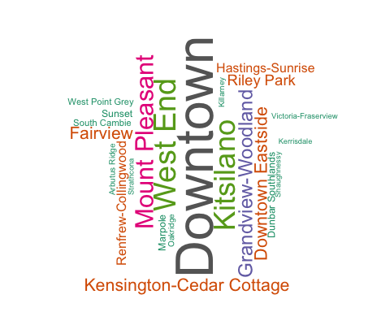
Word Cloud for Airbnb
Most popular place is Downtown.

Slide 4
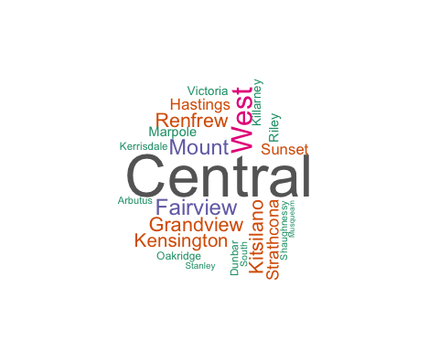
Word Cloud for Crime
Highest crime rate is in Central, West End and Mount-Pleasant.

Slide 5
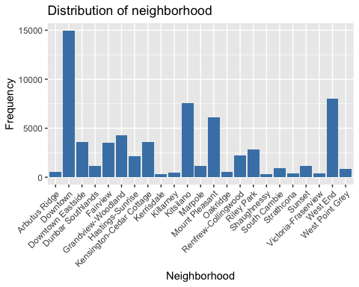
Bar Plot
Downtown has the most number of accommodations.

Slide 6
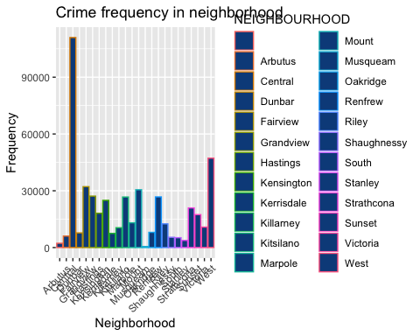
Bar Plot
Central has the highest number of crime.

Slide 7
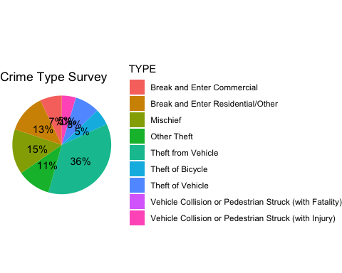
Pie Plot
Theft from Vehicle has the highest crime frequency.

Slide 8
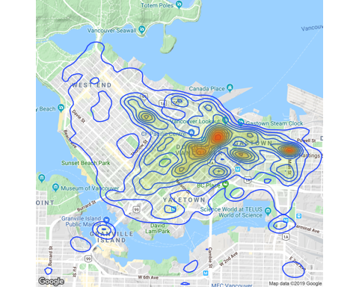
Map
Downtown has the highest crime rate for theft from vehicle.

Slide 9
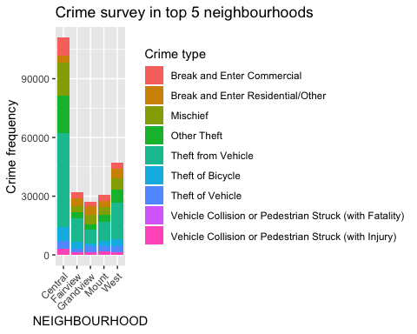
Bar Plot
Theft from vehicle have the highest rate in top five crime rate neighbourhoods.

Slide 10
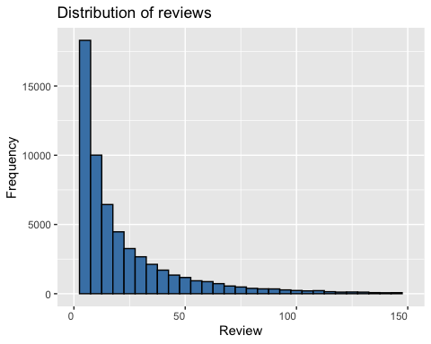
Histogram Plot
Most accommodations does not have reviews.

Slide 11
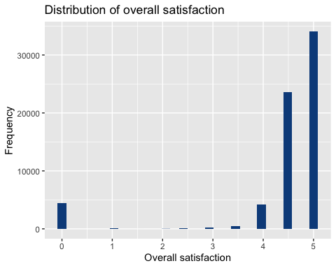
Histogram Plot
Most accommodations have 5 star for satisfaction.

Slide 12
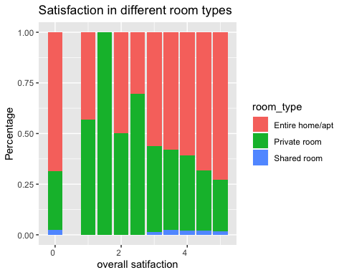
Bar Plot
Entire home/apt has the higher satisfaction from 3 to 5 star.

Slide 13
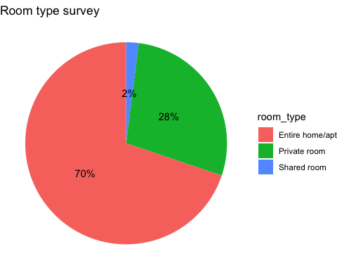
Pie Plot
70% accommodations are entrie home/apt.

Slide 14
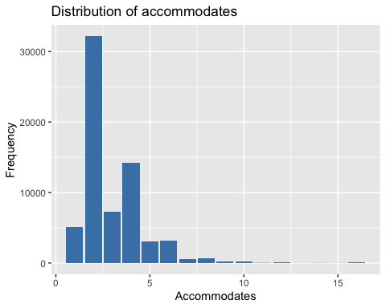
Bar Plot
Most accommodations could include 2 persons.

Slide 15
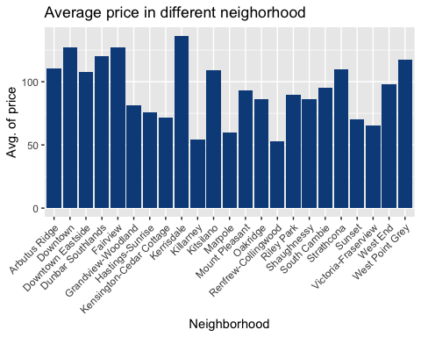
Bar Plot
Kerrisdale has the highest price among neighborhoods.

Slide 16
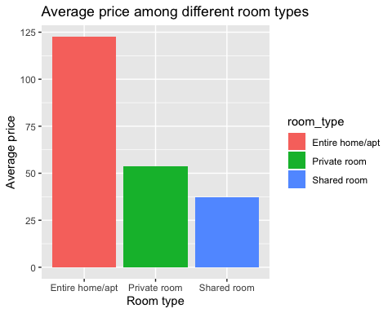
Bar Plot
Entire home/apt is the most expensive room type.

Slide 17
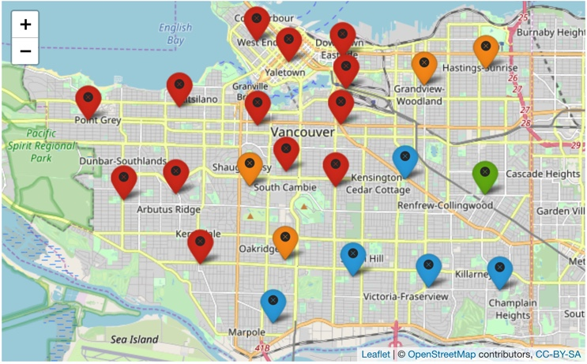
Map
Relatively expensive accommodations are in top left of Vancouver.

Slide 18
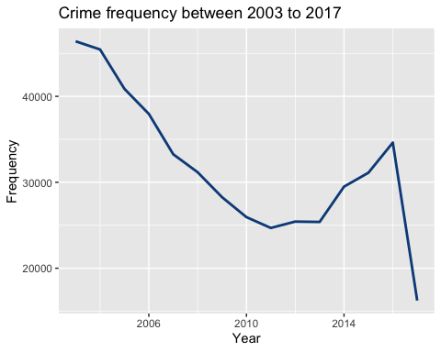
Line Plot
Total crime frequency has already decreased a lot.

Slide 19
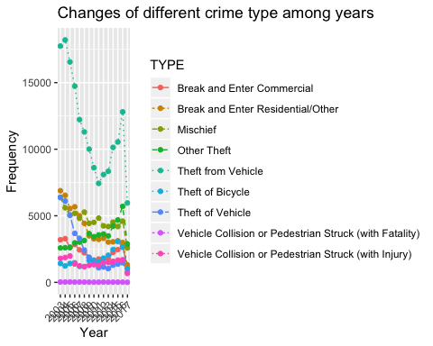
Line Plot
All crime types has already dramatically decreased from 2003 to 2017.

Slide 20
Conclusion:
The most popular places for travelers are also have high crime rate. But from the survey, most crime is abour theft from vehicle instead of fatality. So, it is safe for travelers to live in. From the crime survey, it can be seen the total crime number has already decreased.

Slide 21
Reference:
http://tomslee.net
https://en.wikipedia.org/wiki/Airbnb
http://kaggle.com/wosaku/crime-in-vancouver/data
http://map.googleapis.com

